Slide 1
GREECE & THE MEDITERRANEAN ALL-INCLUSIVE CRUISING | 2021 – 2022

Slide 2
Session Plan
Welcome On Board Celestyal
Where do we sail?
Itineraries
Celestyal Crystal
Celestyal Olympia
Celestyal Experience
Q&A Time

Slide 3
WHY CELESTYAL?

Slide 4
Welcome On Board
Celestyal Cruises was born in 2014, built on 84 years of experience by one of the leading travel groups in Cyprus. Home to the city of Athens - the heart of ancient Greece and gateway to the Mediterranean.
Celestyal Cruises has fast built an award winning reputation and recognition as the number one choice for cruisers and travellers to the Greek Islands and Eastern Mediterranean, welcoming over 100,000 guests onboard each year.

Slide 5
What makes us UNIQUE
Our cruises are DESTINATION RICH featuring undiscovered island gems with more time ashore with fully-day and overnight extended stays to explore the authentic heart of the destination.
Our concept is ALL-INCLUSIVE protecting our guests from any hidden costs and ensuring our trade partners earn commission on all components.
The DURATIONS OF OUR CRUISES are designed to suit all guest types and durations from short breaks (3 & 4 nights) to longer 7 or 14-nights holidays.
Our vessels are MID-SIZED SHIPS that uniquely access smaller harbours and therefore accommodate lower guests numbers in a homely atmosphere, whilst not compromising on personal space.
We have been recognised globally by guests, travel partners and specialist groups having received multiple and consecutive annual awards for our EXCEPTIONAL HOSPITALITY & UNIQUE ITINERARIES.

Slide 6
All Inclusive Experience
Onboard dining
Unlimited classic drinks
Selected shore excursions
Onboard entertainment
Gratuities
Celestyal Promise

Slide 7
Group Travel
THE MORE THE MERRIER
Whether you are an extended family or a special interest group, we welcome gatherings from all over the world onboard our ships and treat them to unforgettable Greek hospitality which lives long in the memory.
THOSE LITTLE EXTRAS
Our dedicated team can arrange tailor-made itineraries with, pre and post optional extras including flights, hotels, transfers, excursions, access to attractions and group dining options ashore. We can also organise meeting facilities and much more.
GROUP DINING
We can cater for your group throughout our restaurants onboard. If you would like to organise private dining, special menus or hold cocktail parties this can all be arranged in advance of your cruise.

Slide 8
Solo Travel
At Celestyal we are deeply committed to solo travellers and ensuring you have a wonderful cruise experience.
Whether you’re taking some me time, or enjoy your personal space with your very own stateroom when travelling with others, Celestyal gives you plenty of options to plan your solo cruise holiday.
SINGLE OCCUPANCY DISCOUNT
We offer a reduced single supplement on our interior and exterior staterooms across all our cruises.

Slide 9
Dining - A gastronomic journey!
Nothing more represents Celestyal’s rooted Greek heritage than its food and passion for serving the freshest local ingredients.
The Galley team take our guests on an amazing gastronomic journey to the heart of the Mediterranean and beyond with a deliciously mouth-watering selection of Greek and international dishes.

Slide 10
Destination Immersion
Our regional expertise. We lead the way in showcasing the region like no other with an unbeatable mix of destinations, durations and experiences on and off the ship.
Every day we take a little inspiration onboard our ships from the heart of the destinations we visit, allowing our guests to continue to experience the sights, sounds, flavours and tastes even when the ship is sailing away onto the next destination.

Slide 11
Our People Make the Difference
From the Captain down, every single member of the crew will greet you with a warm smile, and is dedicated to making sure your Celestyal cruise is perfect from beginning to end.
All members of our dedicated housekeeping staff will do their utmost to make sure you have every possible comfort, offering a flawless, cheerful, polite, attentive and professional service throughout.

Slide 12
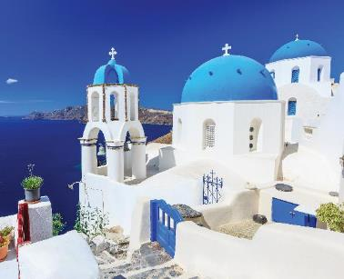
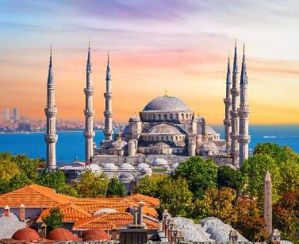
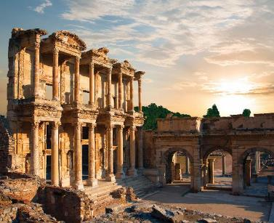
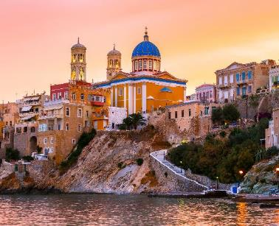
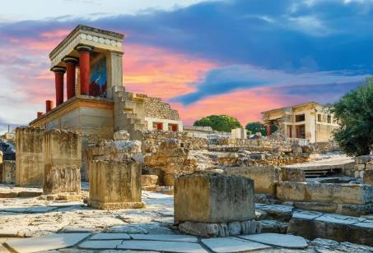
^{Where do we sail?}

Slide 13
ITINERARIES

Slide 14
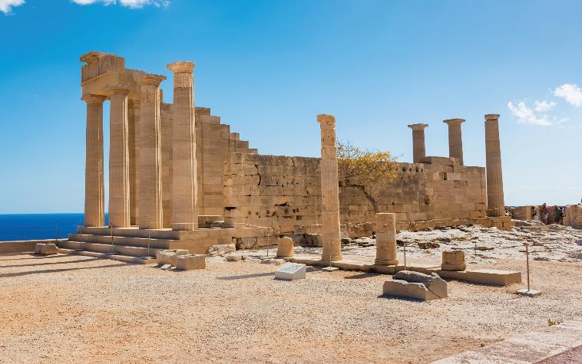
^{(June – Aug)} ^{7 night All-Inclusive cruise}
^{Idyllic AEGEAN}
Athens | Kusadasi | Rhodes | Santorini Lavrio | Mykonos | Milos | Agios Nikolaos
^{Included excursions}
^{• Ephesus, Kusadasi}
^{• Acropolis of Lindos, Rhodes}

Slide 15
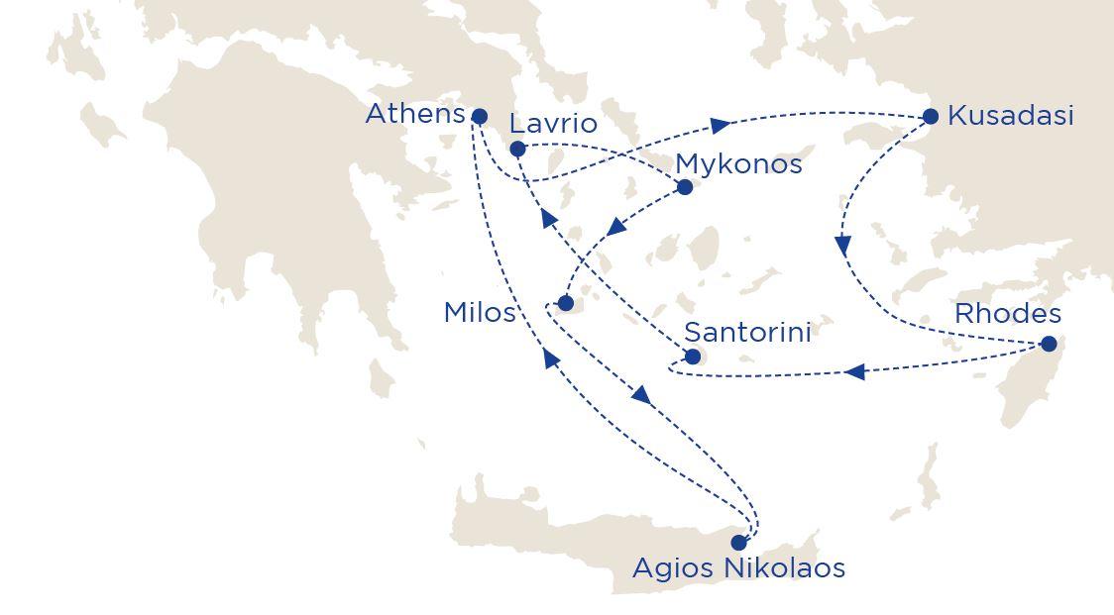
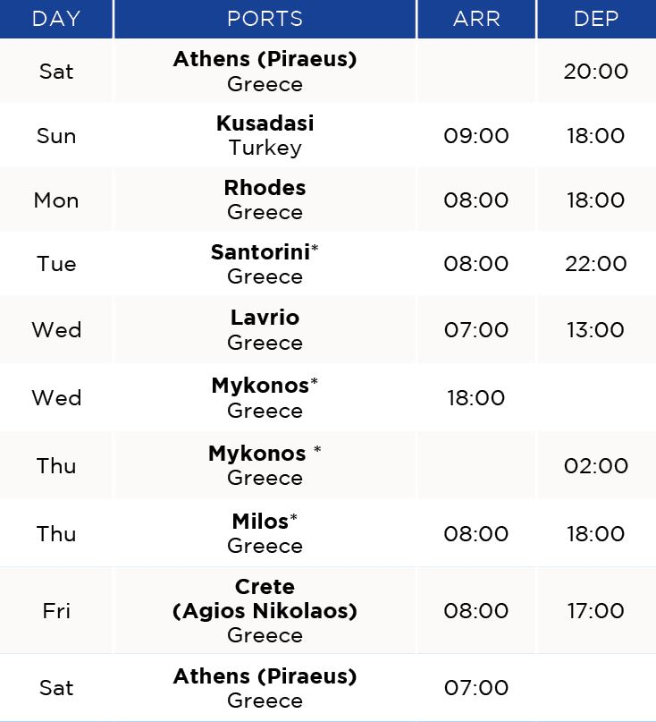
^{(June – Aug)} ^{7 night All-Inclusive cruise}
^{Idyllic AEGEAN}
2021 sailing dates:
June 12, 19, 26
July 03, 10, 17, 24, 31
August 07, 14, 21
*Tendering weather permitting.
Why not start your cruise in Kusadasi.

Slide 16
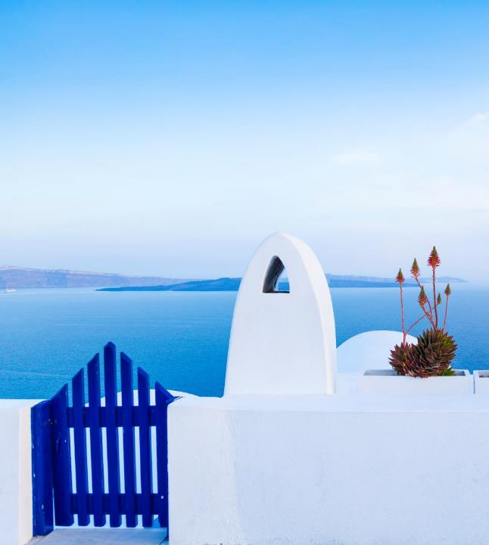
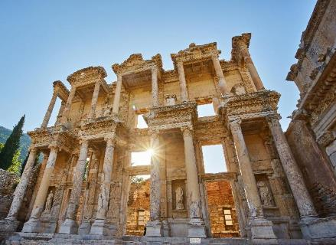
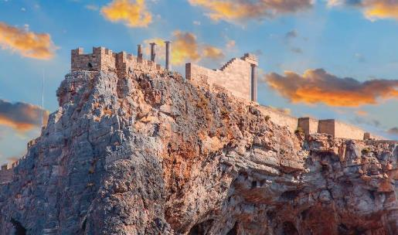
^{Idyllic AEGEAN}
^{7 night All-Inclusive cruise}
Athens | Kusadasi | Rhodes | Agios Nikolaos ^{Santorini | Milos | Mykonos}
^{Included excursions}
^{• Ephesus, Kusadasi}
^{• Acropolis of Lindos, Rhodes}

Slide 17
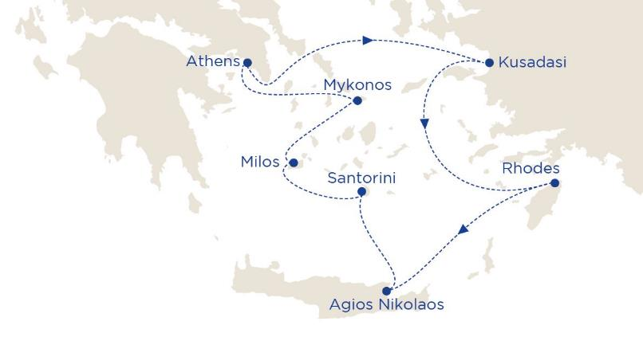
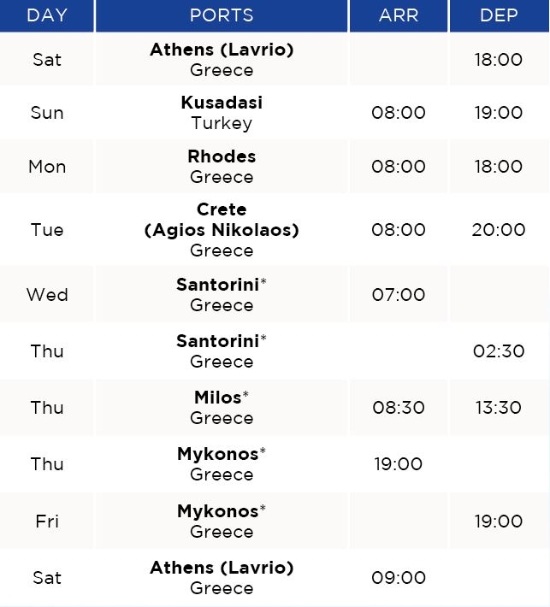
^{Idyllic AEGEAN}
^{7 night All-Inclusive cruise}
2021 sailing dates:
August 28**
September 04, 11, 18, 25
October 02, 09
2022 sailing dates:
April 30
May 07, 14, 21, 28
June 04, 11, 18, 25
July 02, 09, 16, 23, 30
August 06, 13, 20, 27
September 03, 10, 17, 24
October 01, 08
*Tendering weather permitting.
**Cruise Departs Athens (Piraeus)
Why not start your cruise in Kusadasi.

Slide 18
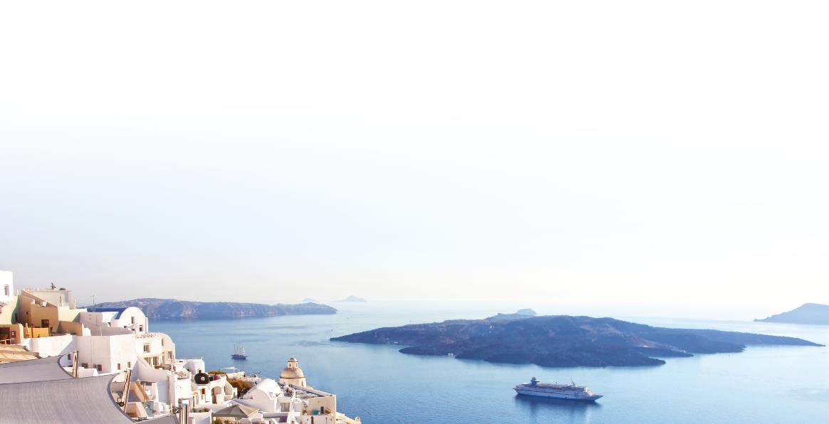
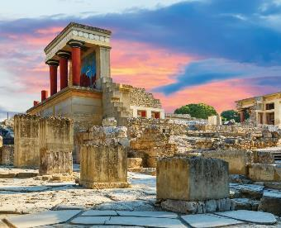
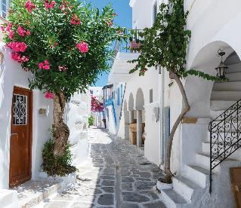
^{Idyllic AEGEAN}
^{Pre-Book Excursions Packages}
^{PRE-BK EXCURSIONS PACKAGE}
^{MYKONOS}
^{AGIOS NIKOLAOS}
^{SANTORINI}
For our full range of excursions please ^{ask for our special brochure}
Mykonian countryside tour with Chora and
Little Venice Duration: App 3 hrs ^{Tour code: MYK – 06}
The Palace of Knossos & Cosmopolitan Heraklion ^{Duration: Half day}
^{Tour code: AGH – 06}
Spectacular Oia Village perched on the Caldera rim Duration: Half day ^{Tour code: SAN-01}
^{SPECIALOFFER}
^{Book More,} ^{Save More}

Slide 19
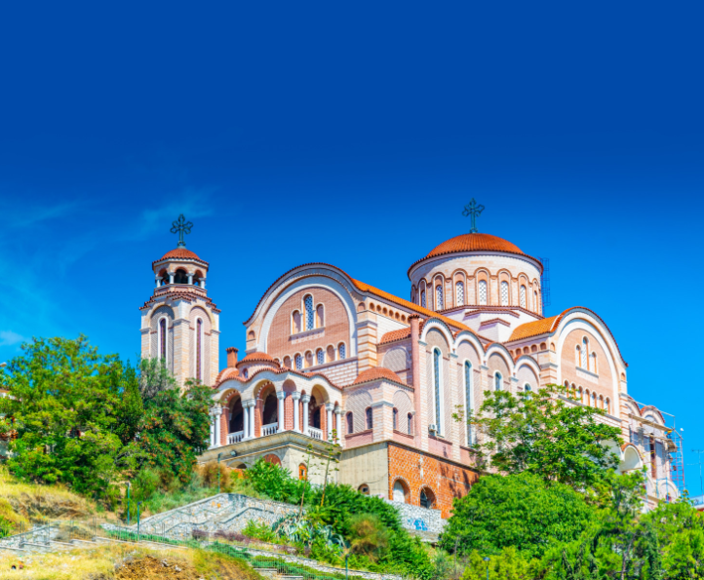
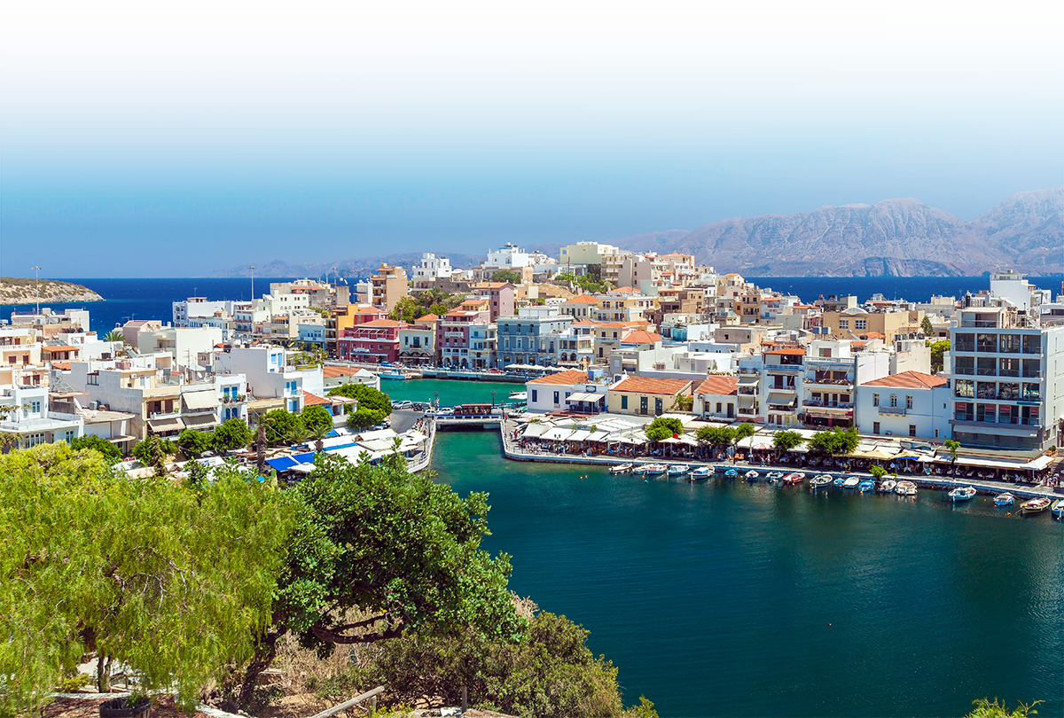
^{Legendary Archipelago}
^{7 night All-Inclusive cruise}
ATHENS | THESSALONIKI | MYKONOS | SANTORINI RHODES | LIMASSOL | AGIOS NIKOLAOS
^{Included excursions}
^{• Walking Tour in Rhodes}
^{• Walking Tour in Limassol}

Slide 20
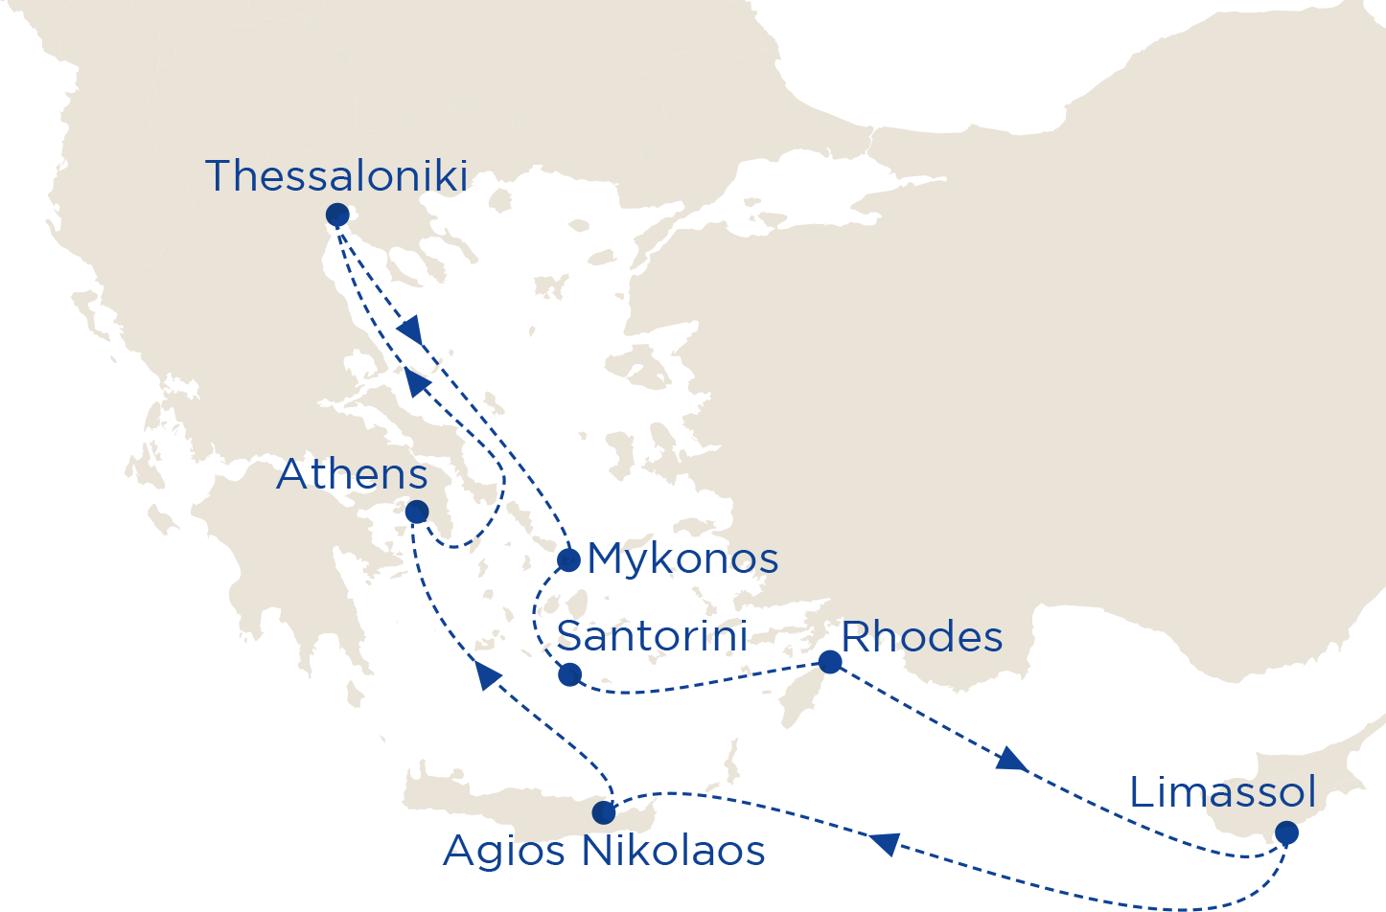
^{Legendary Archipelago}
^{7 night All-Inclusive cruise}
DAY | PORTS | ARR | DEP
MON | Athens (Lavrio) Greece |  | 18:00
TUE | Thessaloniki Greece | 09:30 | 18:00
WED | Mykonos* Greece | 10:00
THU | Mykonos* Greece |  | 02:00
THU | Santorini* Greece | 09:00 | 22:00
FRI | Rhodes Greece | 08:00 | 14:00
SAT | Limassol Cyprus | 08:00 | 14:00
SUN | Crete (Agios Nikolaos) Greece | 14:00 | 19:30
MON | Athens (Lavrio) Greece | 07:30
2021 sailing dates:
June 28
July 05, 12, 19, 26
August 02, 09, 16, 23
*Tendering weather permitting.
Why not start your cruise from Thessaloniki, Limassol, Rhodes or Crete

Slide 21
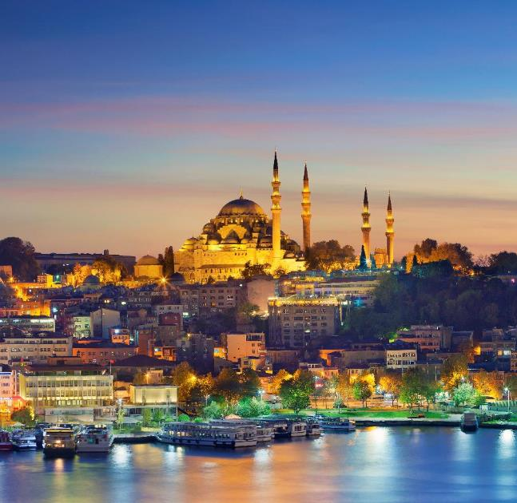
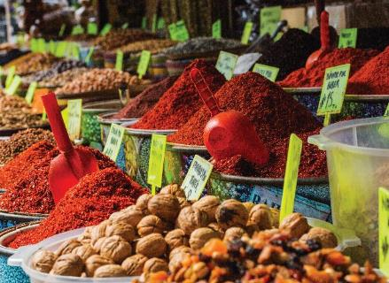
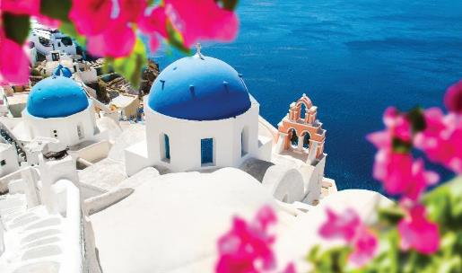
^{Eclectic AEGEAN}
^{7 night All-Inclusive cruise}
^{Athens | Istanbul | Çanakkale}
Thessaloniki | Volos | Santorini
^{Included excursions}
• Bosphorus Cruise and Spice Market, Istanbul
^{• Oia Village, Santorini}

Slide 22
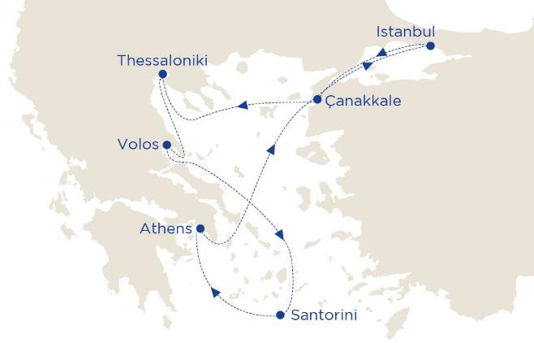
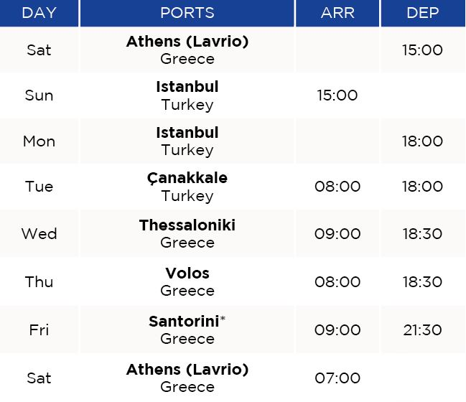
^{Eclectic AEGEAN}
^{7 night All-Inclusive cruise}
*Tendering weather permitting.
Why not start your cruise in Thessaloniki or Istanbul.
2021 sailing dates:
October 23, 30
November 06
2022 sailing dates:
April 09, 16, 23
October 29
November 05, 12

Slide 23
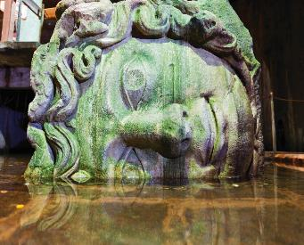
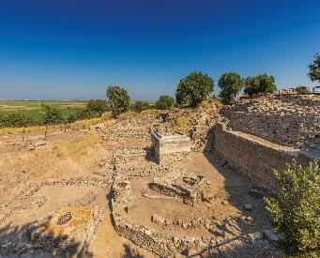
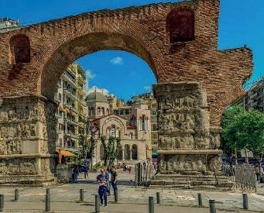
^{Eclectic AEGEAN}
^{Pre-Book Excursions Packages}
^{ISTANBUL}
^{CANNAKALE}
^{THESSALONIKI}
For our full range of excursions please ^{ask for our special brochure}
Discover the hidden secrets of Sultanahmet Square
Duration: Half day | Tour code: IST-13
^{Legendary Troy} Duration: Half day | Tour code: CAN-01
^{Panoramic Thessaloniki} Duration: Half day | Tour code: THS-06
^{SPECIALOFFER}
^{Book More,} ^{Save More}

Slide 24
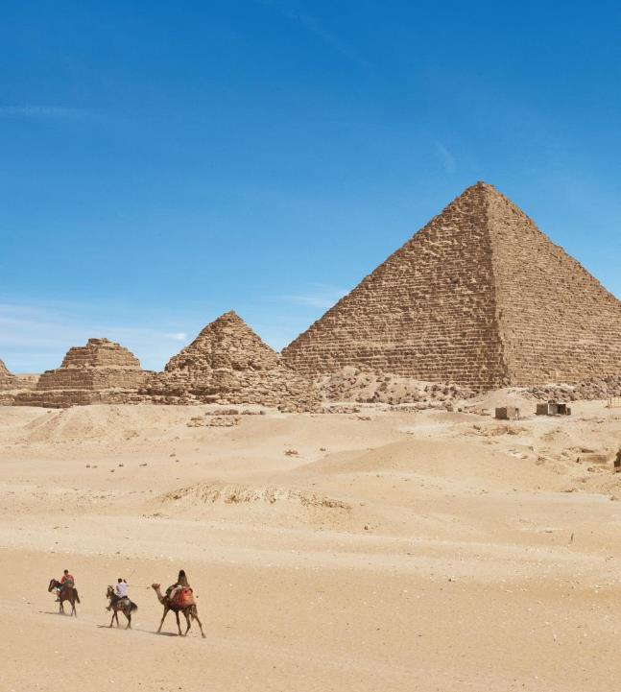
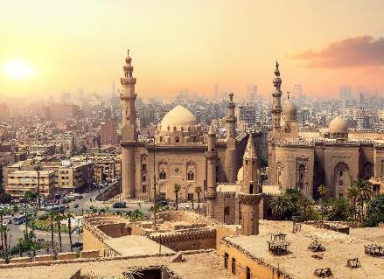
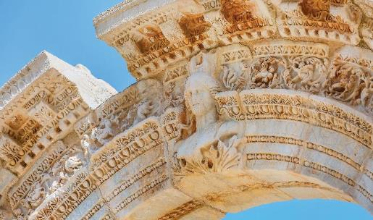
^{Three CONTINENTS}
^{7 night All-Inclusive cruise}
^{Athens | Port Said | Ashdod} ^{Limassol | Rhodes | Kusadasi}
^{Included excursions}
^{• Classic Cairo, Egypt}
^{• Ephesus, Kusadasi}

Slide 25
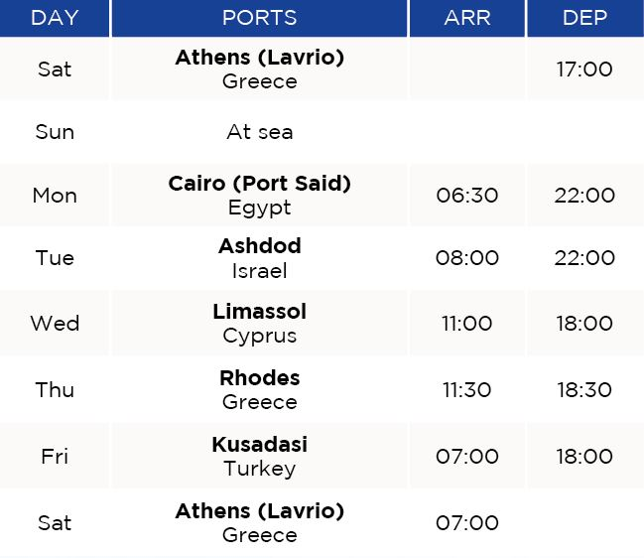
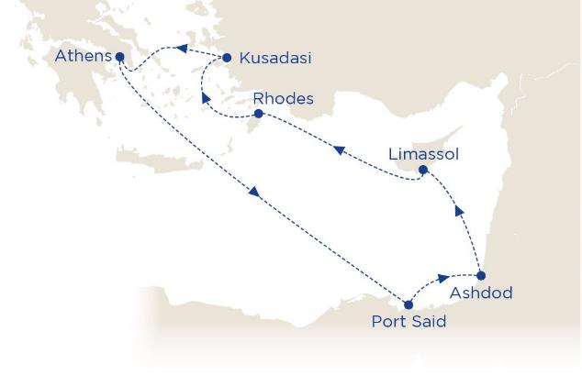
^{Three CONTINENTS}
^{7 night All-Inclusive cruise}
Why not start your cruise in Limassol.
2021 sailing dates:
November 20, 27
December 04, 11, 18, 25^
2022 sailing dates:
March 05, 12, 19, 26
April 02
November 19, 26
December 03, 10, 17, 24, 31
^Guests departing on the 25 December 2021 sailing will receive an extra night onboard in Athens at the end of their journey. You will disembark on 2 January 2022.

Slide 26
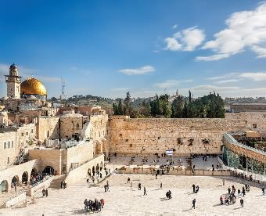
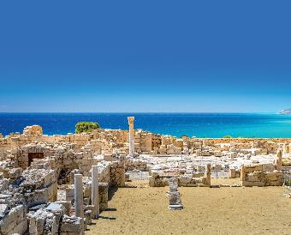
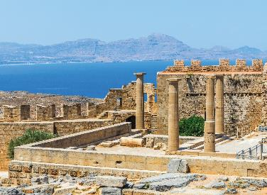
^{Three CONTINENTS}
^{Pre-Book Excursions Packages}
^{ASHDOD}
^{LIMASSOL}
^{RHODES}
For our full range of excursions please ^{ask for our special brochure}
^{Jerusalem & Bethlehem}
^{Duration: Full day} ^{Tour code: ASH – 01}
^{Panoramic Limassol & Curium} ^{Duration: Half day}
^{Tour code: LIM - 01}
Acropolis of Lindos and the Citadel of the Knights Duration: Half day ^{Tour code: RHO – 01}
^{SPECIALOFFER}
^{Book More,} ^{Save More}

Slide 27
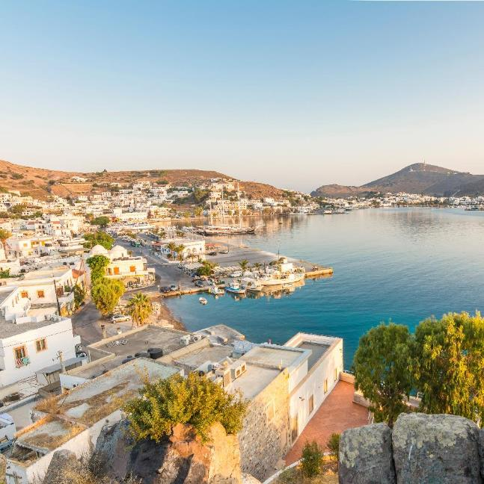
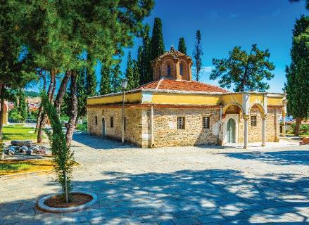
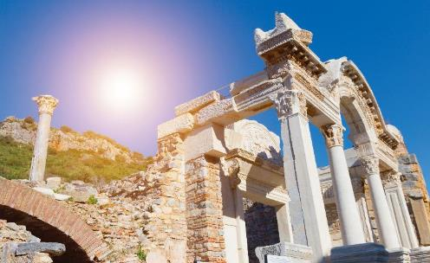
^{Steps of PAUL}
^{7 night All-Inclusive cruise}
^{Athens | Thessaloniki | Kavala} Istanbul | Dikili | Kusadasi | Patmos
^{Included excursions}
^{• Veria, Thessaloniki}
• Ephesus and Miletus, Kusadasi

Slide 28
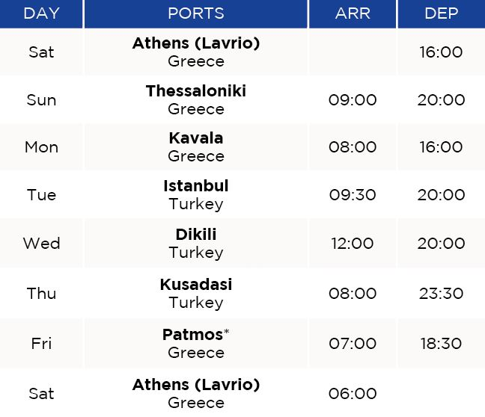
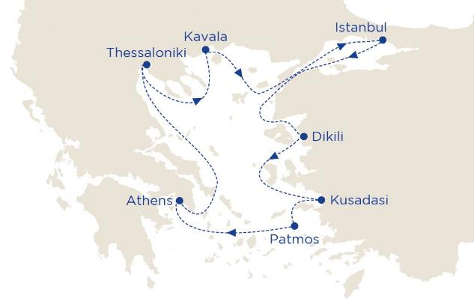
^{Steps of PAUL}
^{7 night All-Inclusive cruise}
*Tendering weather permitting.
2021 sailing dates:
October 16
November 13
2022 sailing dates:
October 15, 22

Slide 29
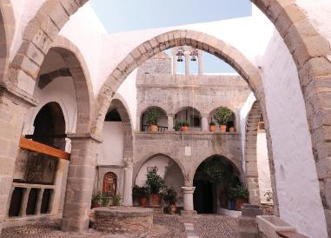
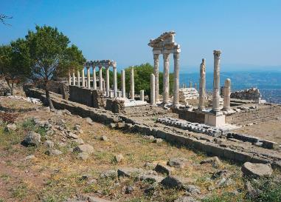
^{Steps of PAUL}
^{Pre-Book Excursions Package}
^{PATMOS}
^{DIKILI}
^{SPECIALOFFER}
For our full range of excursions please ^{ask for our special brochure}
^{Book More,} ^{Save More}
Religious visit to St John’s Monastery - Grotto of Apocalypse Duration: Half day | Tour code: PAT-01
^{Ancient Pergamon}
Duration: Half day | Tour code: DKL-04

Slide 30
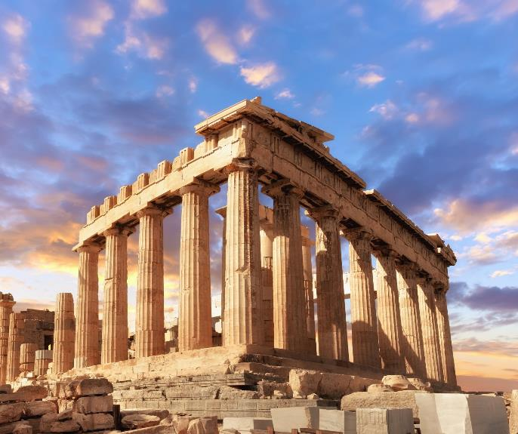
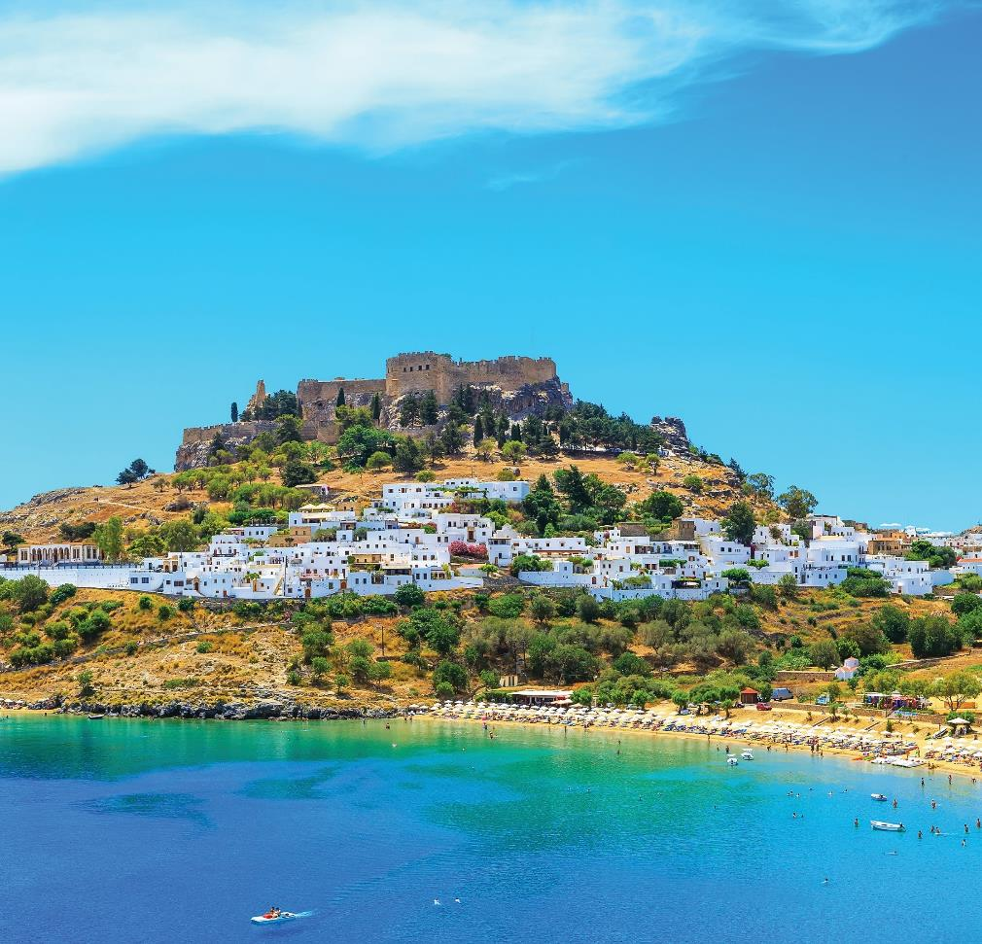
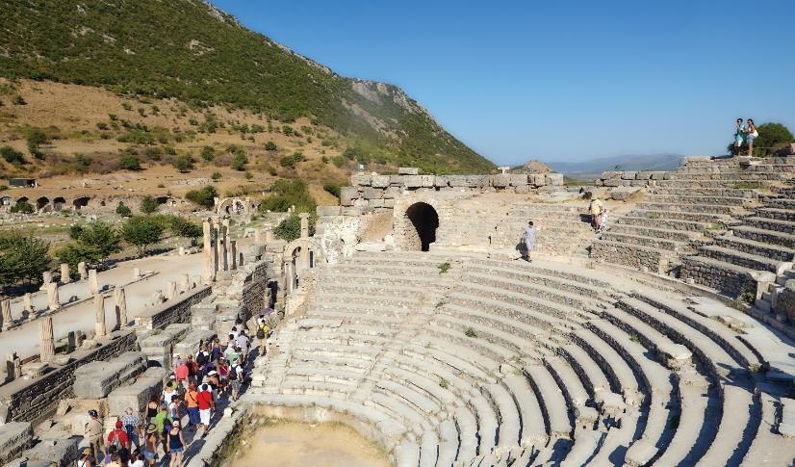
^{Idyllic AEGEAN}
^{4 night All-Inclusive cruise}
^{Athens | Kusadasi | Rhodes}
^{Santorini | Lavrio}
^{Included excursions}
^{• Ephesus, Kusadasi}
^{• Acropolis of Lindos, Rhodes}

Slide 31
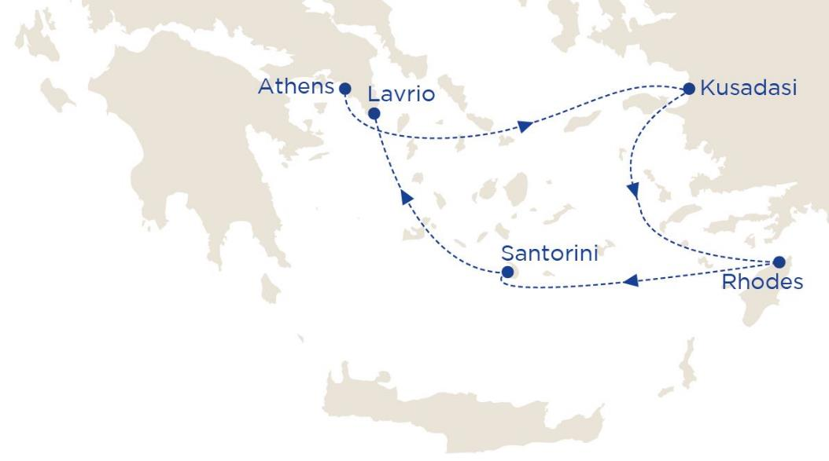
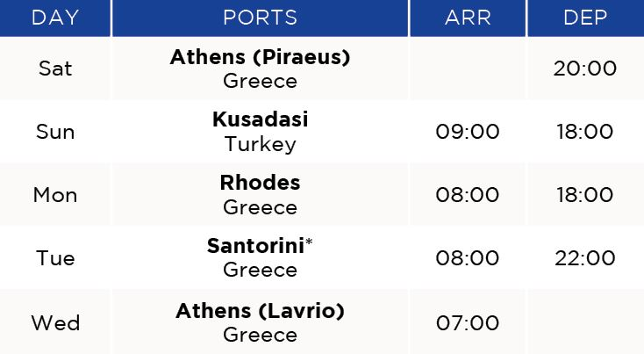
^{Idyllic AEGEAN}
^{4 night All-Inclusive cruise}
*Tendering weather permitting.
2021 sailing dates:
June 12, 19, 26
July 03, 10, 17, 24, 31
August 07, 14, 21

Slide 32
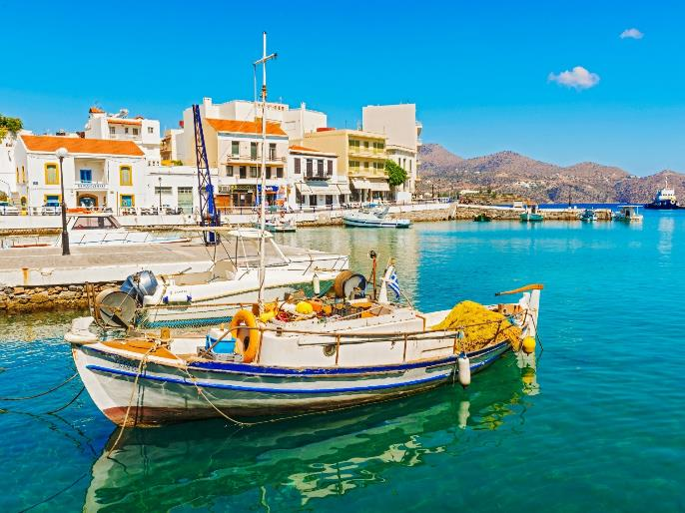
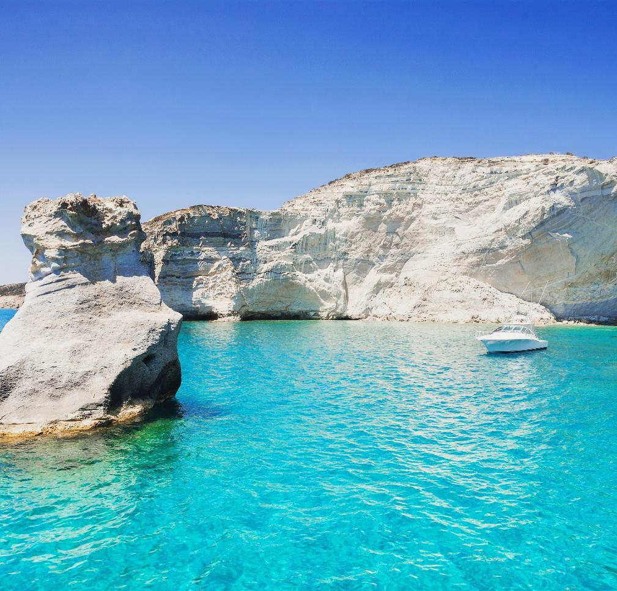
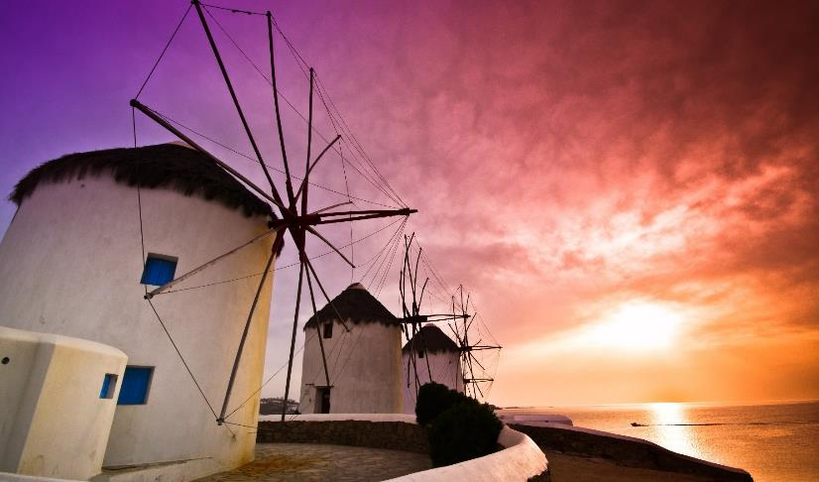
^{Idyllic AEGEAN}
^{3 night All-Inclusive cruise}
^{Lavrio | Mykonos | Milos}
^{Agios Nikolaos | Athens}
^{Included excursions}
^{• Milos & Plaka, Milos}
^{• Agios Nikolaos, Crete}

Slide 33
^{Idyllic AEGEAN}
^{3 night All-Inclusive cruise}
*Tendering weather permitting.
2021 sailing dates:
June 16, 23, 30
July 07, 14, 21, 28
August 04, 11, 18, 25

Slide 34
^{Iconic DISCOVERY}
3 & 4 night All-Inclusive cruises
^{Athens | Syros | Kusadasi} ^{Rhodes (4nt only) | Santorini}
^{Included excursions}
^{• Syros walking tour}
^{• Ancient Ephesus, Kusadasi}

Slide 35
^{Iconic DISCOVERY}
^{3 night All-Inclusive cruise}
*Tendering weather permitting.
Why not start your cruise in Kusadasi.
2021 sailing dates:
October 29
November 05, 12, 19, 26
2022 sailing dates:
March 04, 11
November 04, 11, 18, 25

Slide 36
^{Iconic DISCOVERY}
^{Pre-Book Santorini Excursions}
^{SANTORINI}
^{SANTORINI}
For our full range of excursions please ^{ask for our special brochure}
^{Akrotiri Village Excavations} ^{Duration: Half day}
^{Tour code: SAN - 08}
Spectacular Oia Village perched on the Caldera rim ^{Duration: Half day}
^{Tour code: SAN - 01}

Slide 37
^{Iconic DISCOVERY}
^{4 night All-Inclusive cruise}
*Tendering weather permitting.
Why not start your cruise in Kusadasi.
2021 sailing dates:
October 25
November 01, 08, 15, 22
2022 sailing dates:
March 07
October 31
November 07, 14, 21

Slide 38
^{Iconic DISCOVERY}
^{Pre-Book Excursions Package}
^{RHODES}
^{SANTORINI}
^{SPECIALOFFER}
For our full range of excursions please ^{ask for our special brochure}
^{Book More,} ^{Save More}
Acropolis of Lindos and the Citadel of the Knights
^{Duration: Half day} ^{Tour code: RHO - 01}
Spectacular Oia Village perched on the Caldera rim ^{Duration: Half day}
^{Tour code: SAN - 01}

Slide 39
^{Iconic AEGEAN}
3 & 4 night All-Inclusive cruises
Athens | Mykonos | Kusadasi | Patmos Rhodes (4nt only) | Crete (Heraklion) | Santorini
^{Included excursions}
^{• Ancient Ephesus, Kusadasi}
• Palace of Knossos, Crete (3nt only)
• Acropolis of Lindos, Rhodes (4nt only)

Slide 40
^{Iconic AEGEAN}
^{3 night All-Inclusive cruise}
*Tendering weather permitting.
Why not start your cruise in Kusadasi.
2021 sailing dates:
September 03, 10, 17, 24
October 01, 08, 15, 22
2022 sailing dates:
March 18, 25
April 01, 08, 15, 22, 29
May 06, 13, 20, 27
June 03, 10, 17, 24
July 01, 08, 15, 22, 29
August 05, 12, 19, 26
September 02, 09, 16, 23, 30
October 07, 14, 21, 28

Slide 41
^{Iconic AEGEAN}
^{Pre-Book Excursions Package}
^{PATMOS}
^{LIMASSOL}
^{SANTORINI}
^{SPECIALOFFER}
For our full range of excursions please ^{ask for our special brochure}
^{Book More,} ^{Save More}
Religious visit to St. John’s Monastery & Grotto of the Apocalypse Duration: App 3 hrs ^{Tour code: PAT-01}
Spectacular Oia Village perched on the Caldera rim ^{Duration: Half day}
^{Tour code: SAN-01}

Slide 42
^{Iconic AEGEAN}
^{4 night All-Inclusive cruise}
2021 sailing dates:
August 30
September 06, 13, 20, 27
October 04, 11, 18
2022 sailing dates:
March 14, 21, 28
April 04, 11, 18, 25
May 02, 09, 16, 23, 30
June 06, 13, 20, 27
July 04, 11, 18, 25
August 01, 08, 15, 22, 29
September 05, 12, 19, 26
October 03, 10, 17, 24
*Tendering weather permitting.
Why not start your cruise in Kusadasi.

Slide 43
^{Iconic AEGEAN}
^{Pre-Book Excursions Package}
^{HERAKLION}
^{SANTORINI}
^{SPECIALOFFER}
For our full range of excursions please ^{ask for our special brochure}
^{Book More,} ^{Save More}
Minoan Palace of Knossos - 1st European Civilisation
Duration: Half day | Tour code: HER - 02
Spectacular Oia Village perched on the Caldera rim Duration: Half day | Tour code: SAN - 01

Slide 44
OUR SHIPS

Slide 45
^{Celestyal CRYSTAL}
· 1,200 guests in 480 staterooms, 53 with private balcony
· All staterooms are equipped with telephone, hairdryer, safety ^{deposit box & TV}
^{· Minibar in all suites}
· Fully air-conditioned, WiFi and doctor on board
· Two restaurants and five bars
· Outdoor pool, gym, sauna and beauty centre

Slide 46
^{Celestyal CRYSTAL}

Slide 47
^{Celestyal OLYMPIA}
· 1,664 guests in 724 staterooms, 9 with private balcony
· All staterooms are equipped with telephone, hairdryer, safety ^{deposit box & TV}
^{· Minibar in all suites}
· Fully air-conditioned, WiFi and doctor on board
· Two restaurants and seven bars
· Two outdoor pools, gym, sauna and beauty centre

Slide 48
^{Celestyal OLYMPIA}

Slide 49
^{Celestyal EXPERIENCE}
· 1,800 guests in 789 staterooms
· All Staterooms are equipped with a shower, minibar, telephone, hairdryer, safety deposit box & TV
· Fully air-conditioned, WiFi and doctor on board
· Six restaurants and seven bars
· Two pools, two Jacuzzi’s and the Beach Club
^{· Sana Wellness and Spa}

Slide 50
^{Celestyal EXPERIENCE}
^{Dining}

Slide 51
^{Celestyal EXPERIENCE}
^{Entertainment}

Slide 52
^{Celestyal EXPERIENCE}
^{Sana Wellness & Spa}

Slide 53
^{Celestyal EXPERIENCE}
^{The Beach Club}

Slide 54
^{A Whole New EXPERIENCE}
Sana Wellness Spa Stateroom Class

Slide 55
^{A Whole New EXPERIENCE}
Sana Wellness Spa Stateroom Class
^{Priority check-in*}
Priority embarkation / disembarkation*
A dedicated Celestyal Suite Concierge*
Private dining area within main dining restaurants*
^{Tranquil deck 14 accommodation}
Unlimited access to the Sana Wellness and Spa area
Unlimited access and use of Thermal Suites
Unlimited access and use of Hydro Treatment area including Thalassotherapy Pool
Priority access to the Speciality Dining Experiences
Exclusive access to The Beach Club
*(Excludes WSJ category staterooms)

Slide 56
^{Cruise with Confidence}
https://celestyal.com/ : Covid Health Protocols
^{Celestyal Promise:}
No cancellation fees up to 90 days prior to departure
Adjust your trip up to 30 days before sailing

Slide 58
Thank You Connect with Celestyal Cruises: Facebook, Instagram, Twitter, LinkedIn

