Slide 1
WEB CHECK-IN REVIEW NEW DIGITAL EMBARKATION

Slide 2
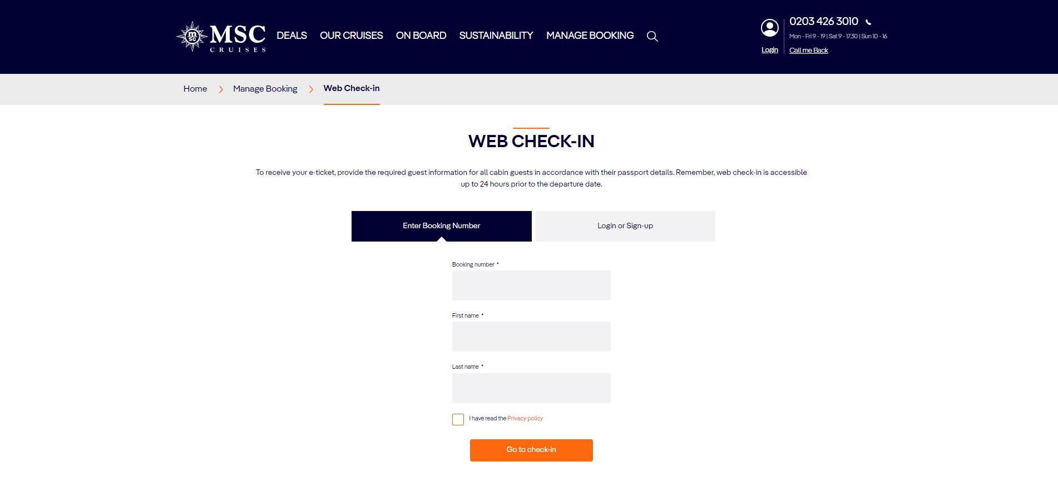
LOG-IN TO BE
Access to Web Check-in is possible with:
Booking nr – Name – Lastname
or
My MSC credential (username – password)
Notes:
Customer can access the web check-in from 30 days up to 24hrs before the cruise departure date
Minors cannot access the web check-in with their data
Web check-in can be performed per cabin

Slide 3
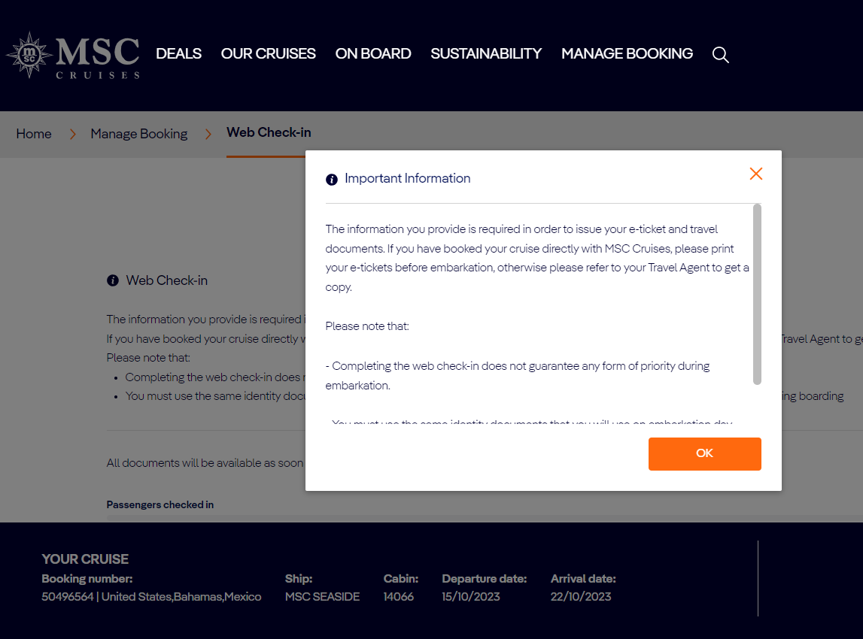
WEB CHECKIN ACCESS – INFORMATIVE POP-UP – NEW!
An informative pop-up can be enabled with specific/important messages to be communicated
to guests before performing the web check-in.
Notes: the pop-up functionality has been released but it is still DISABLED.
It can be enabled upon request by Local web content specialists

Slide 4
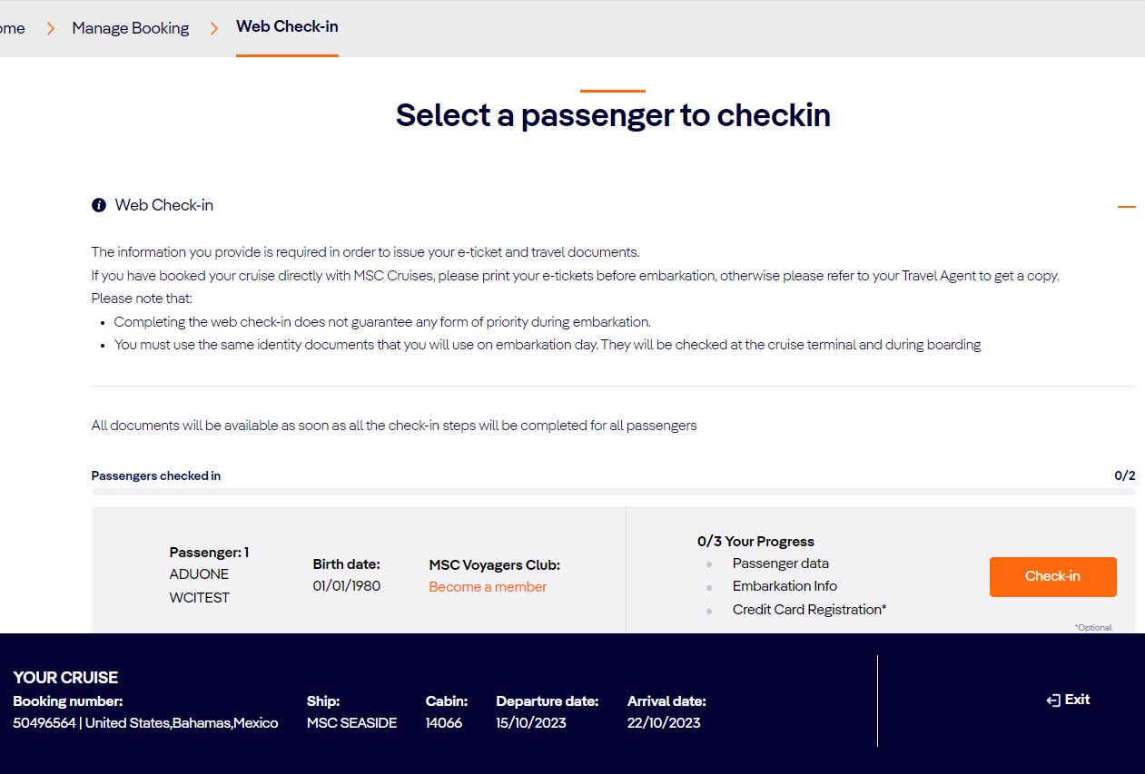
DASHBOARD – PASSENGER SELECTION – NEW!
After logging in all the passengers to check-in are displayed. Two possible actions:
Start the web check-in
Edit info (if the web check-in has already been performed)
Notes:
web check-in can be performed separately by each customer sharing the same cabin;
check-in will be shown as completed when all customers in the cabin have completed the flow;

Slide 5
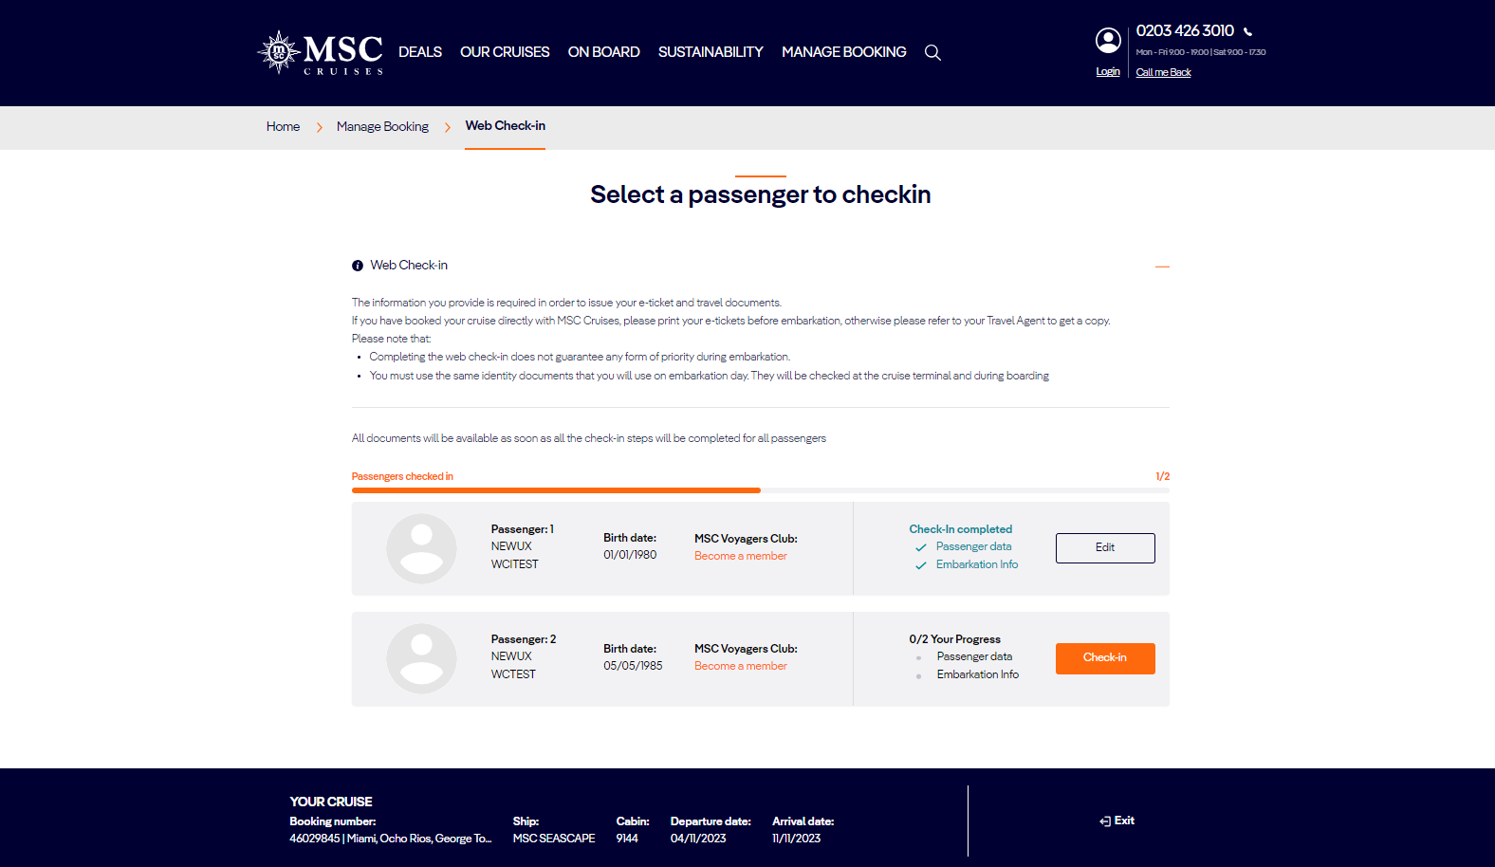
DASHBOARD – PASSENGER SELECTION – PROGRESS BAR – NEW!
NEW!
A progress bar will info about the status of the web check-in
A count of the passengers checked-in will be displayed
Every time a single step is completed it will be colored in green with a flag

Slide 6
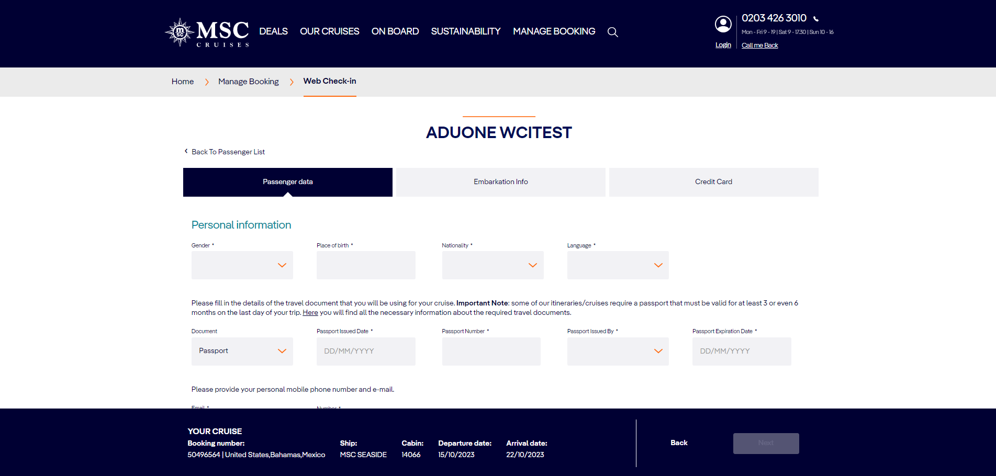
WEB CHECK-IN STEPS – NEW!
Web check-in will consist of 3 steps:
Personal data: where all the personal information (passport, contacts, emergency contact) have to be filled
Embarkation info: in this section it will be collected all the information related with the embarkation day: travel with, security picture, embarkation time slot)
Credit card: an optional possibility to link the credit card for onboard expenses to one customer or all customers in cabin

Slide 7
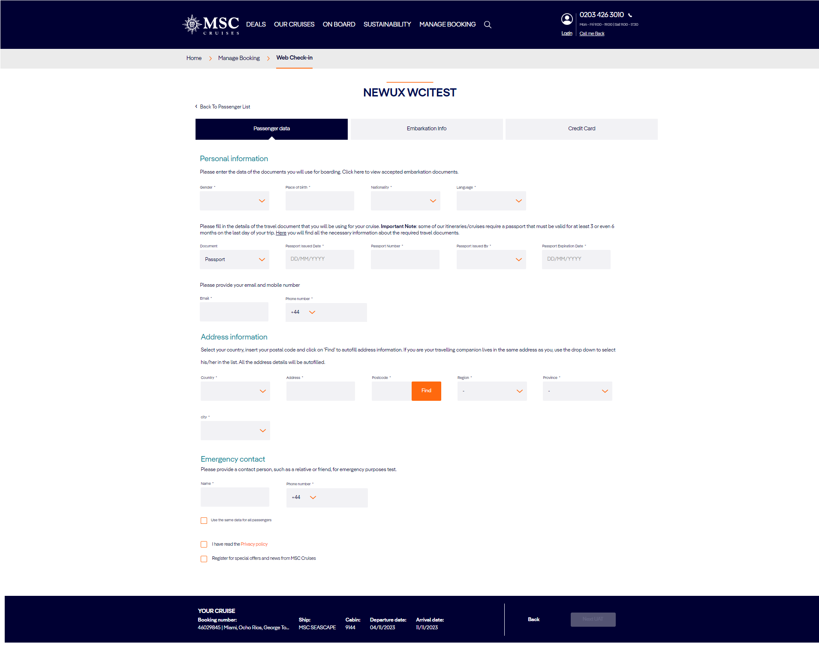
PERSONAL DATA – NEW!
Personal data section is organized in 3 areas:
Personal information to collect passport information, customer contact (email, phone)
Address information to collect customer address information
Emergency contact to collect the information of a relative/friend to be contacted in case of emergency
All personal data are mandatory: if some fields are left blank customers will not be allowed to go ahead to the next step;

Slide 8
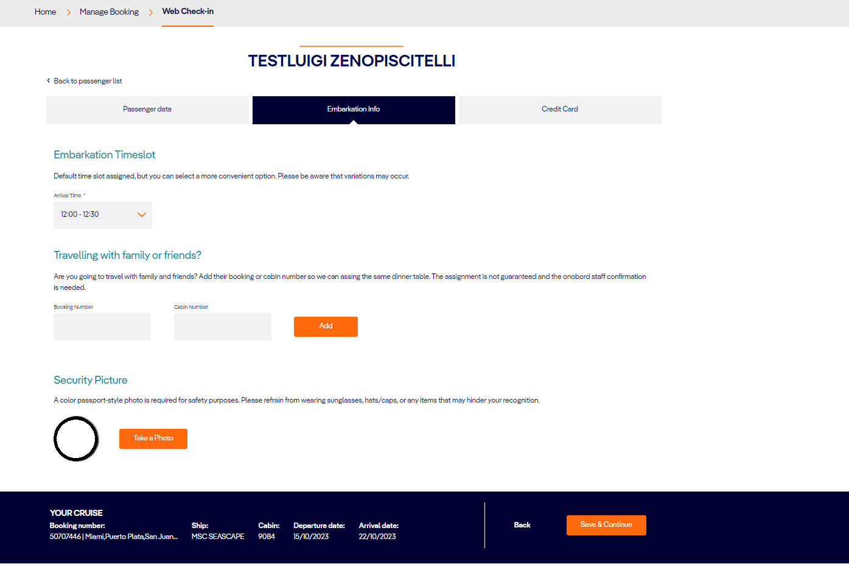
EMBARKATION INFO – NEW!
Embarkation info section consists of 3 areas:
Embarkation time-slot pre-assigned to customers.
If alternative slots are available, customers will be able to change the slot.
!!! Important: only primary guest can change the slot.
In case there are no alternative slots available, the drop down menu will not be selectable;
Travel with: to link one or more booking that will travel together and have the same dinner table assigned. The service is confirmed once onboard.
Security picture to be used during the embarkation process.
!!! Important: it is now mandatory for all the guests in cabin.

Slide 9
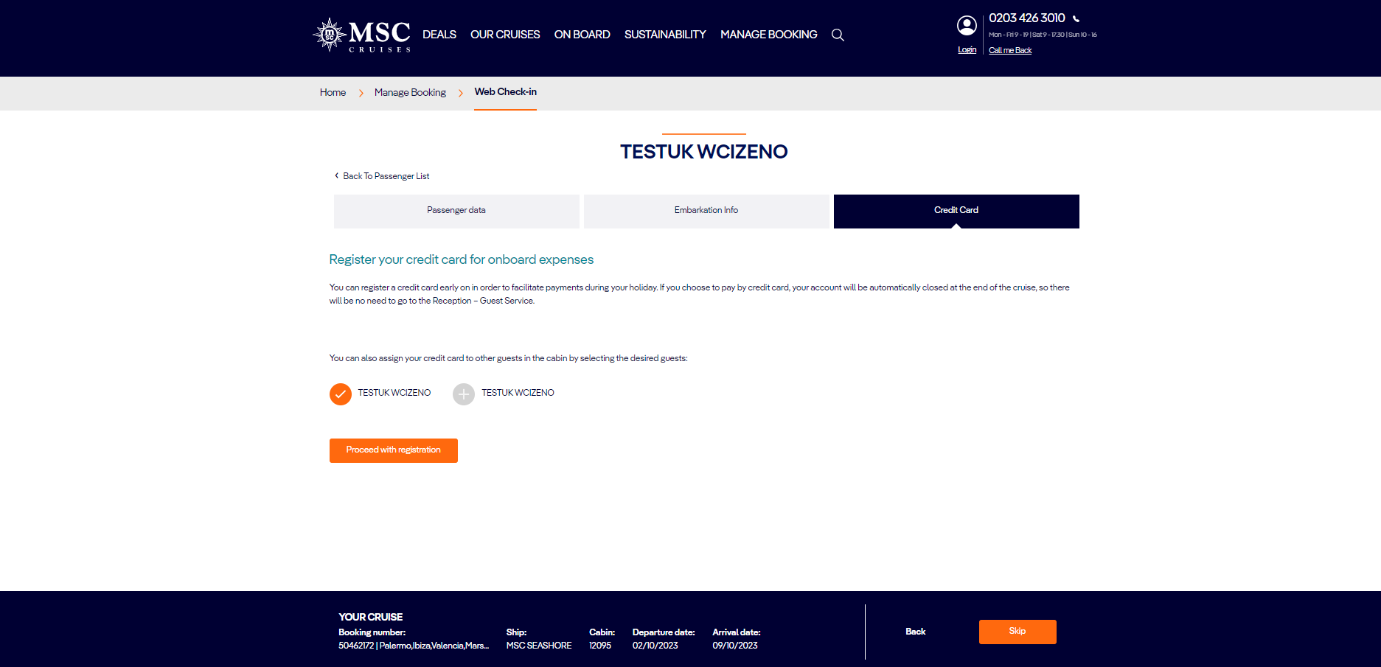
CREDIT CARD REGISTRATION – NEW!
Credit card section is now displayed
to all customers that access the Web Check-in with either Booking nr/Name/Last name or My MSC credential.
- credit card can be linked even to the other guests sharing the same cabin;
- Credit card registration process is only for onboard expenses and not for pre-paid packages purchase.
!!! Important:
Credit card registration is not mandatory.
Once the credit card is linked cannot be removed. A dedicated pop-up will inform customers.

Slide 10
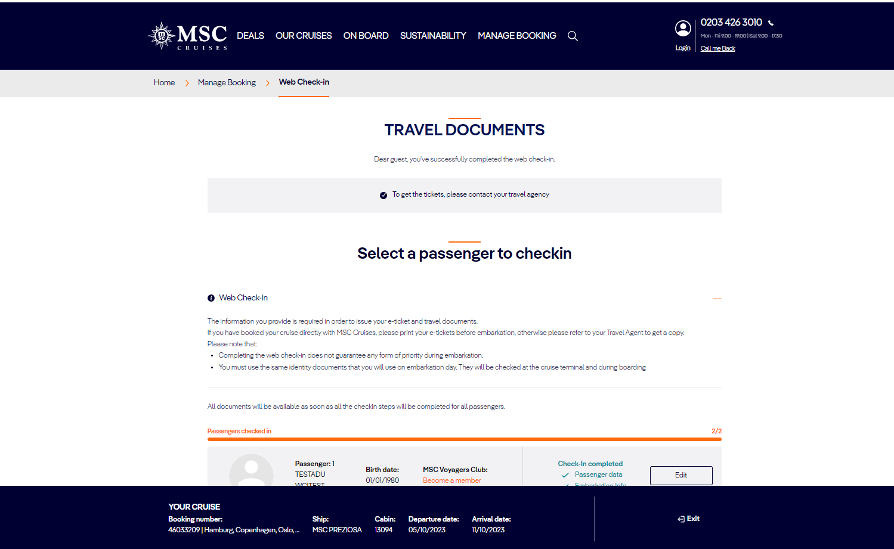
TRAVEL DOCUMENT – B2B SUCCESS – NEW!
The travel documents will not be shown in the dashboard after the web check-in is completed (except for USA and CAN).
For B2B guest a message to contact the travel agency to request the ticket is displayed.

Slide 11
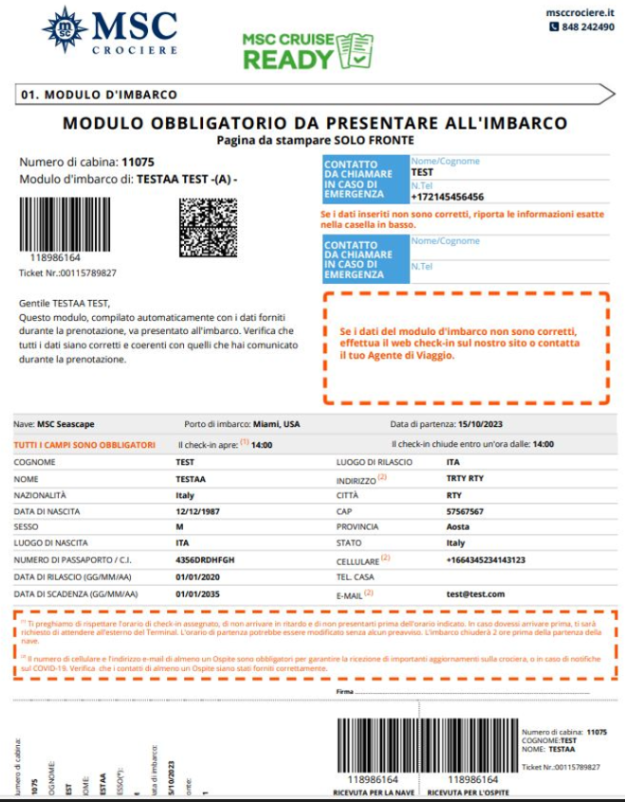
TRAVEL DOCUMENT – B2B SUCCESS – NEW!
for all passengers who have completed the WCI through website or MSC4ME app, a MSC Cruise Ready logo will be shown on the e-ticket (pls see Attachment)
The Logo functionality has been released for e-tickets issued starting from 20th September.
In the next phases of the new Embarkation process, passengers holding an e-ticket with the Logo will benefit from a smoother embarkation process compared to those who have not completed the WCI – please note that for the time being, no priority lane is arranged at check-in.

Slide 12
THANK YOU

